Slide 1
CMU Tartan Zone
Group member:
Sitian Shen
Jiayue Mao
Junrong Li
Shuang Weng

Slide 2
Project description
User Registration
Course Review
Course Group + discussion board
User Authentication

Slide 3
Models
Review
Group
User
Course
DiscussionPosts

Slide 4
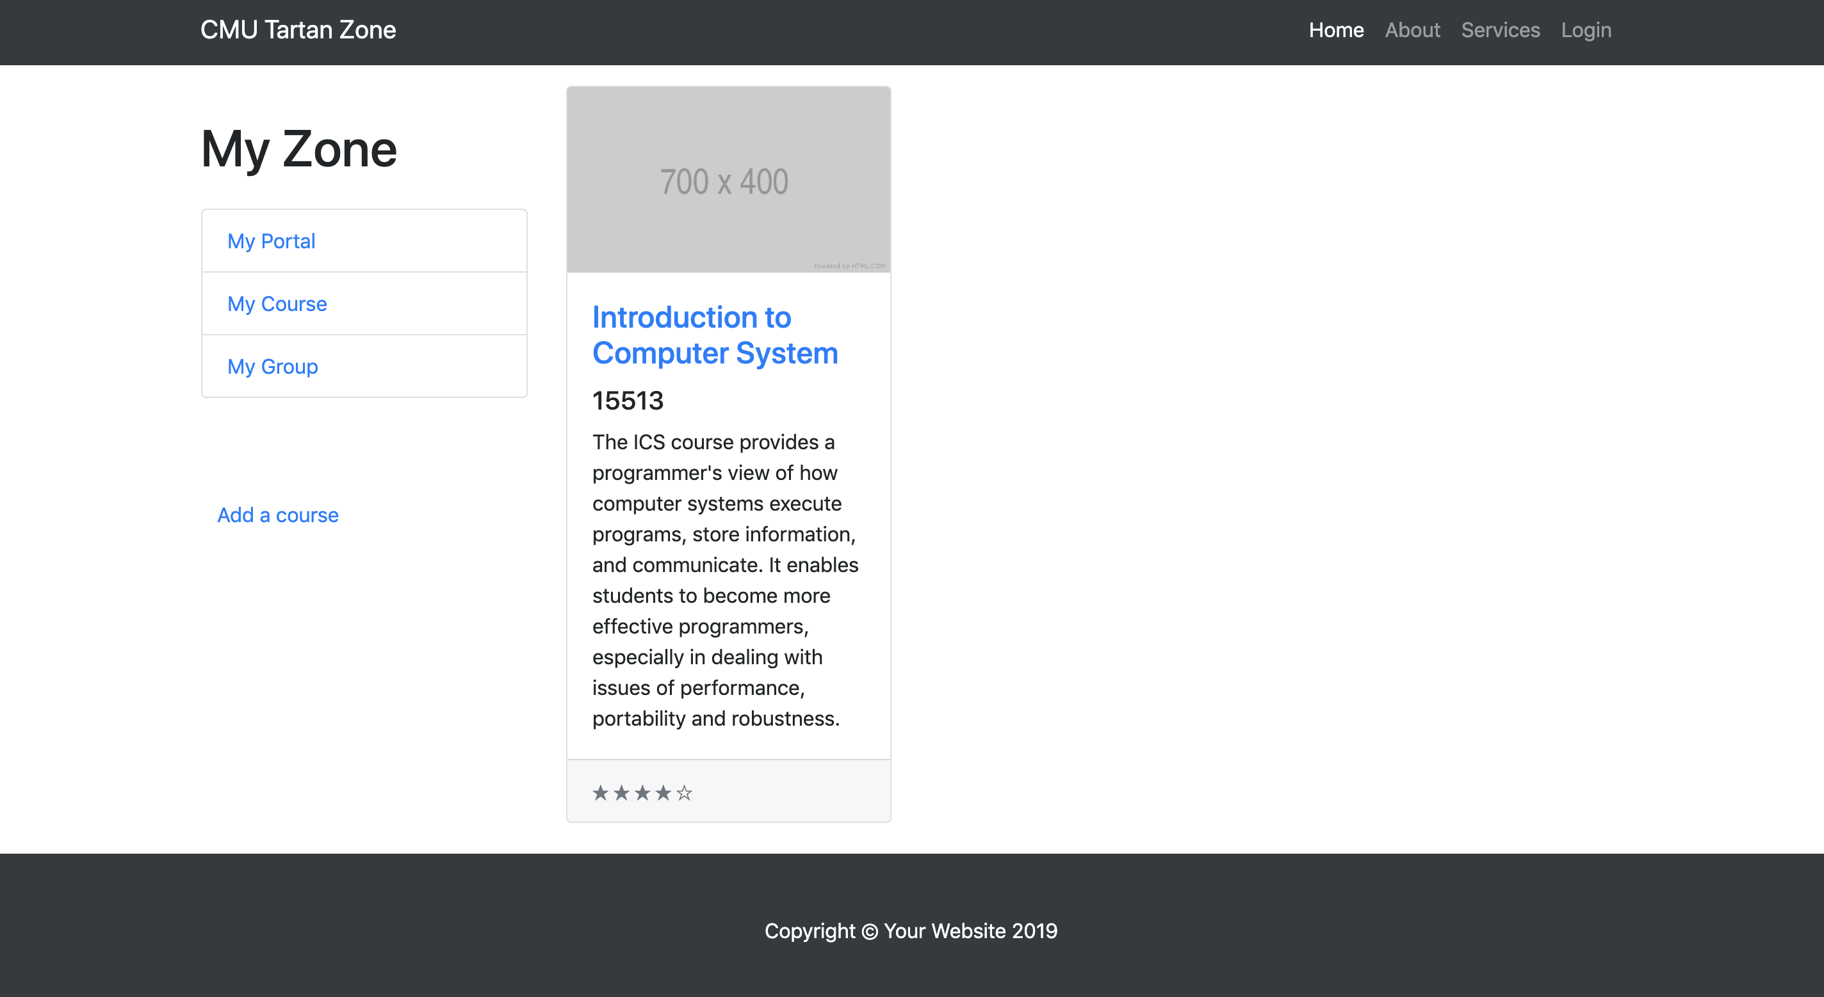

Slide 5
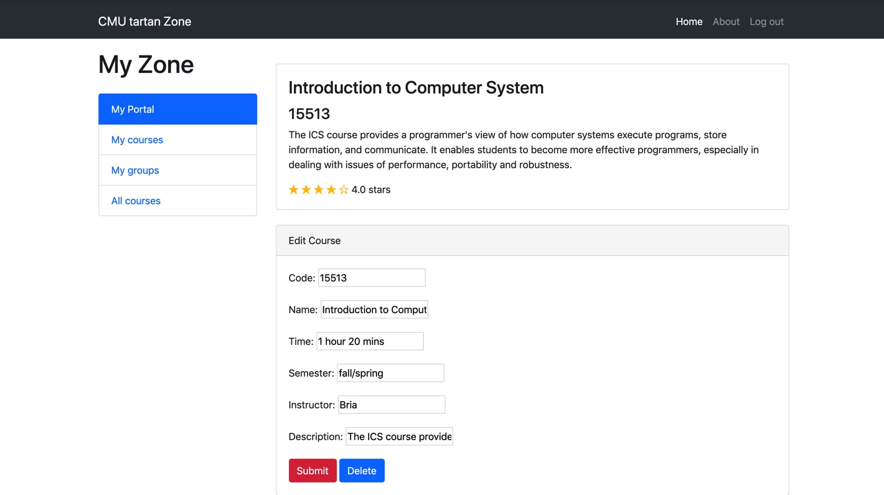
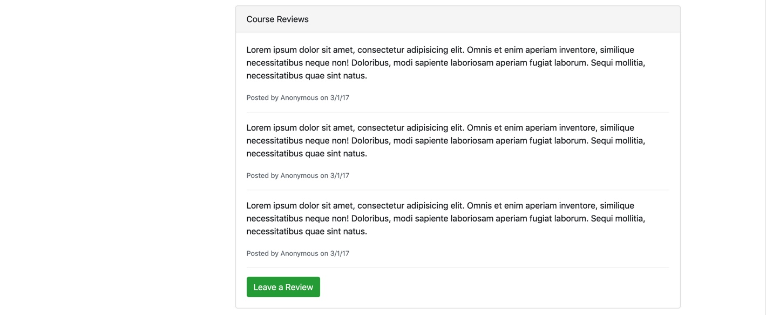
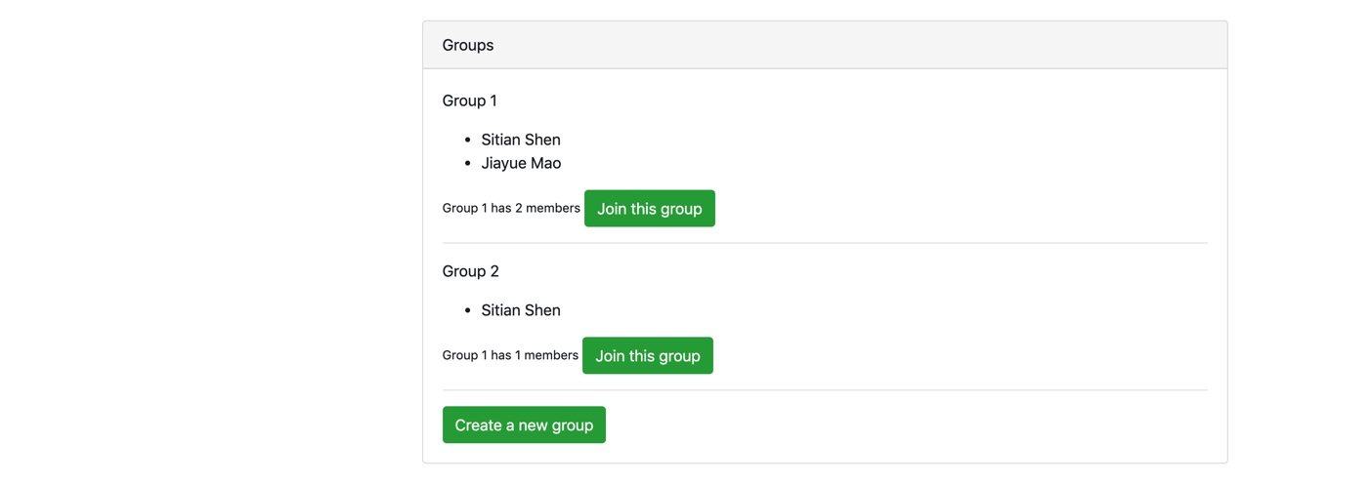
Course Detail

